Slide 1
Social Networking website for business professionals
GitHub: https://github.com/Shreyas0812/legendary-funicular
Shreyas Raorane (RA1811028010016)
Hritwik Mukherjee (RA1811028010017)

Slide 2
Abstract
This is a social networking website designed for business professionals.
Interaction on the platform is not restricted to only companies to students but collaborations between students is also encouraged.
It allows you to share work-related information with other users and keep an online list of professional contacts.

Slide 3
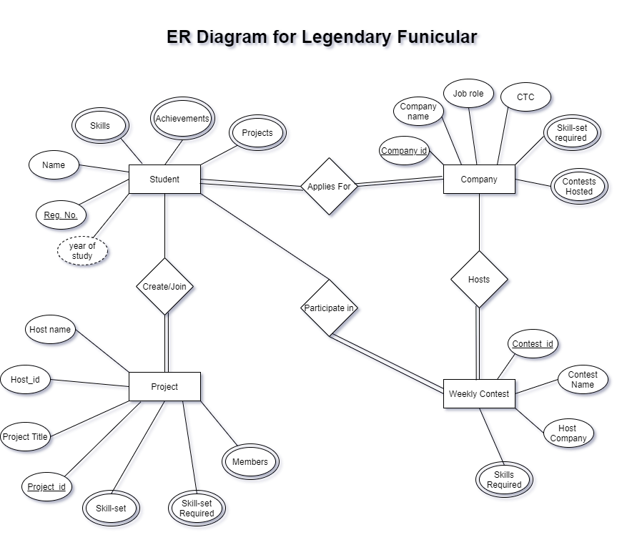

Slide 4
Technologies used:
HTML/CSS : For Designing the Website
JavaScript, NodeJs : For BAckend and Frontend Development
My SQL : For storing data in backend

Slide 5
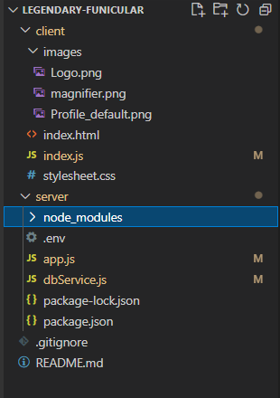
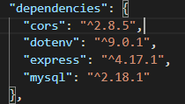
File Structure:
Node Dependencies:

Slide 6
Implementation Tables used:
Students – Holds data regarding students registered on the platform. The data in this table is inclusive of Student ID, Name etc.
Company - Holds data regarding companies registered on the platform. The data in this table is inclusive of Company ID, Company Name etc.
Projects - Holds data regarding projects on the platform. The data in this table is inclusive of Project ID, Project Title etc.
Weekly Contests - Holds data regarding students registered on the platform. The data in this table is inclusive of Contest ID, Contest Name etc.

Slide 7
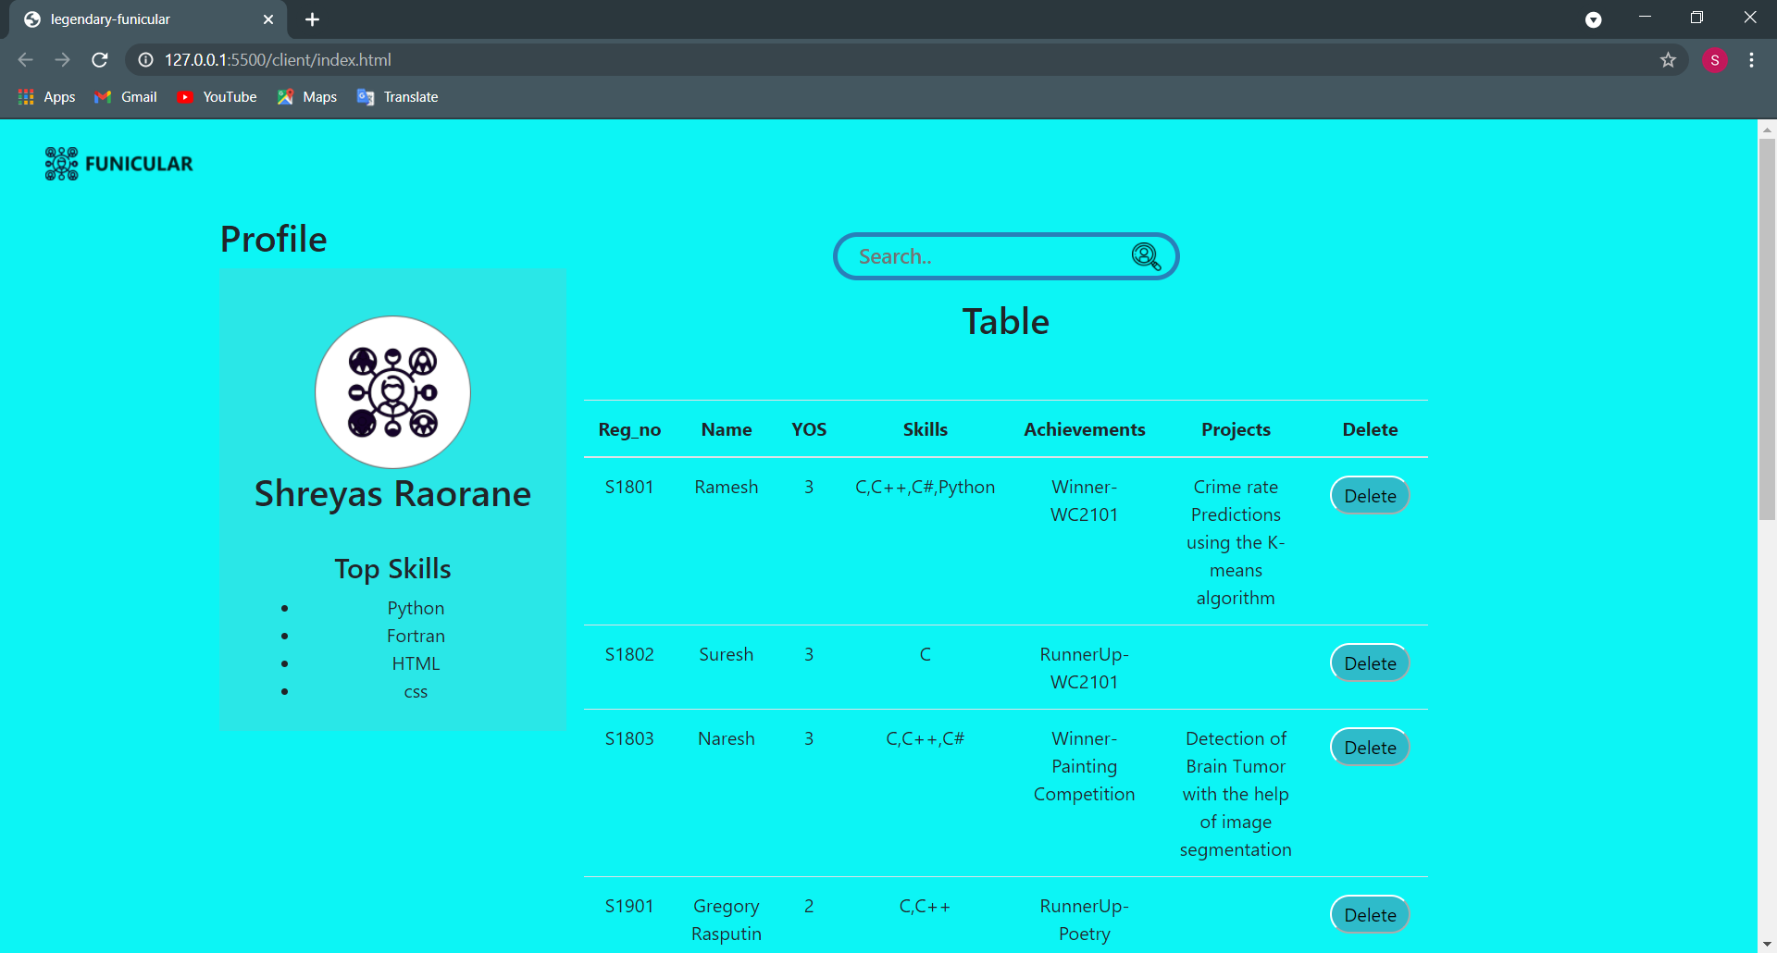
Student:

Slide 8
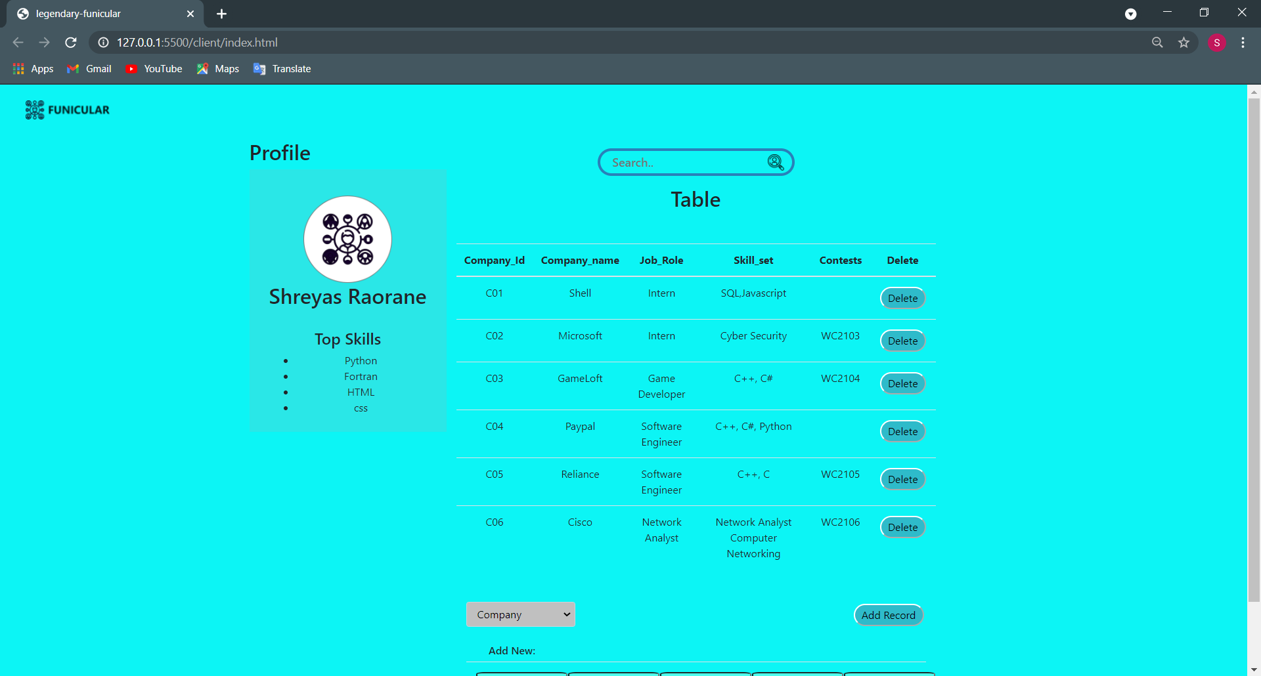
Company:

Slide 9
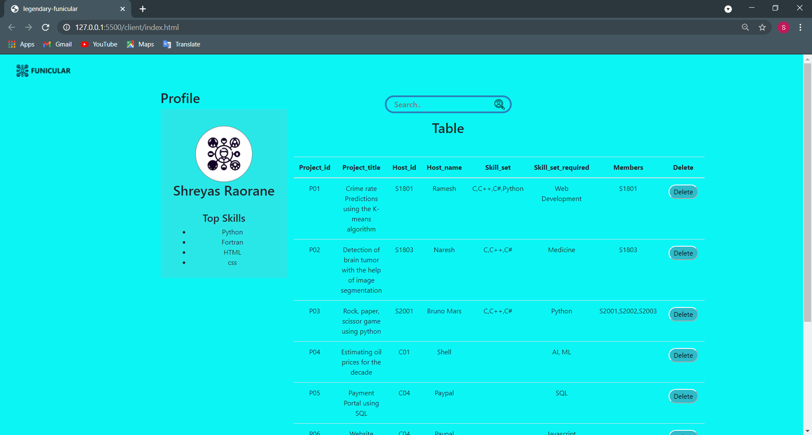
Projects

Slide 10
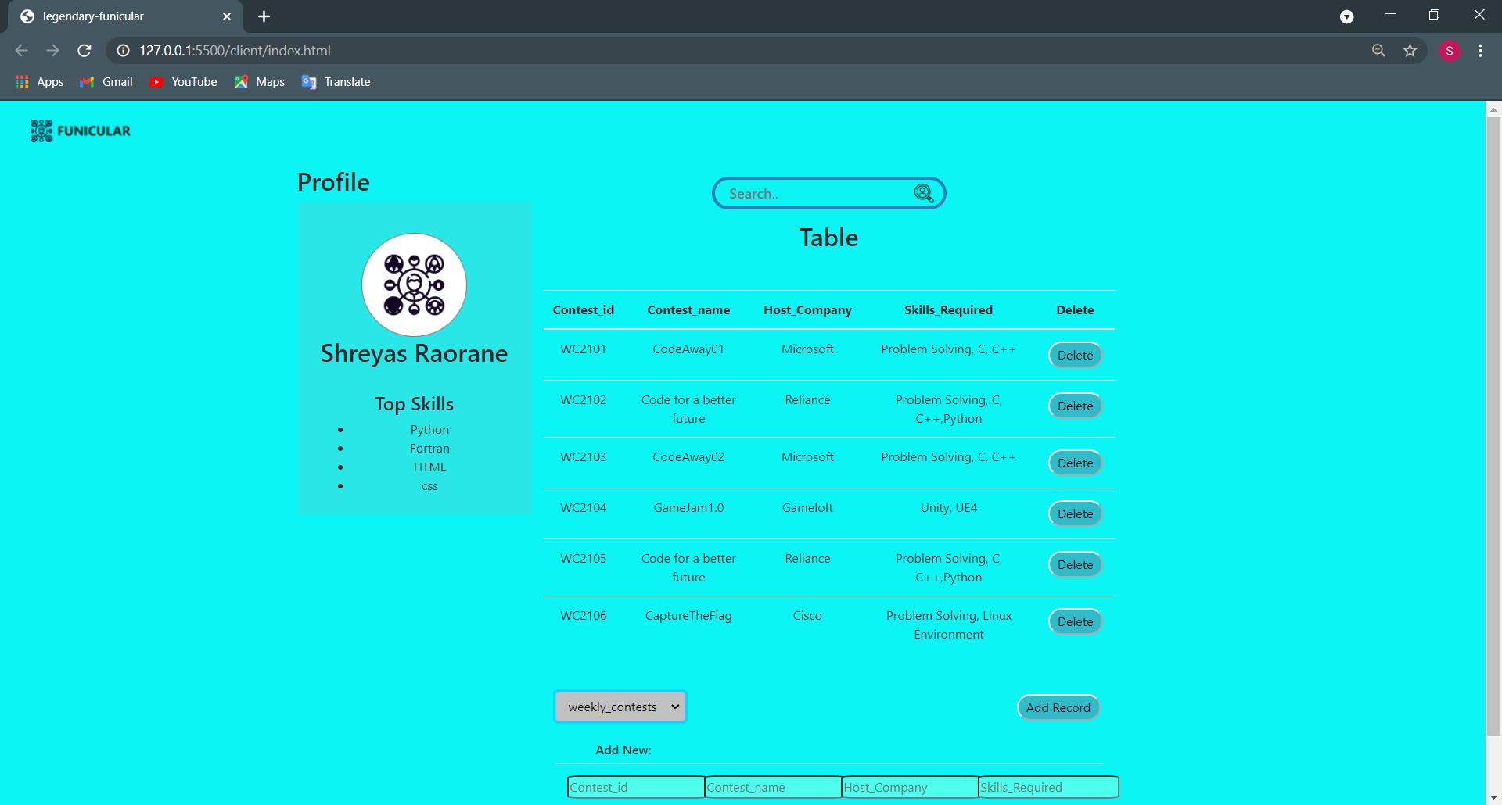
Weekly Contests

Slide 11
Functionalities
Add Entry - Enter the values and click on ‘Add Record’ button
Delete Entry - Click the button adjacent to the entry you want to Delete
Search - Enter value in the search bar to search the table on the screen

Slide 12
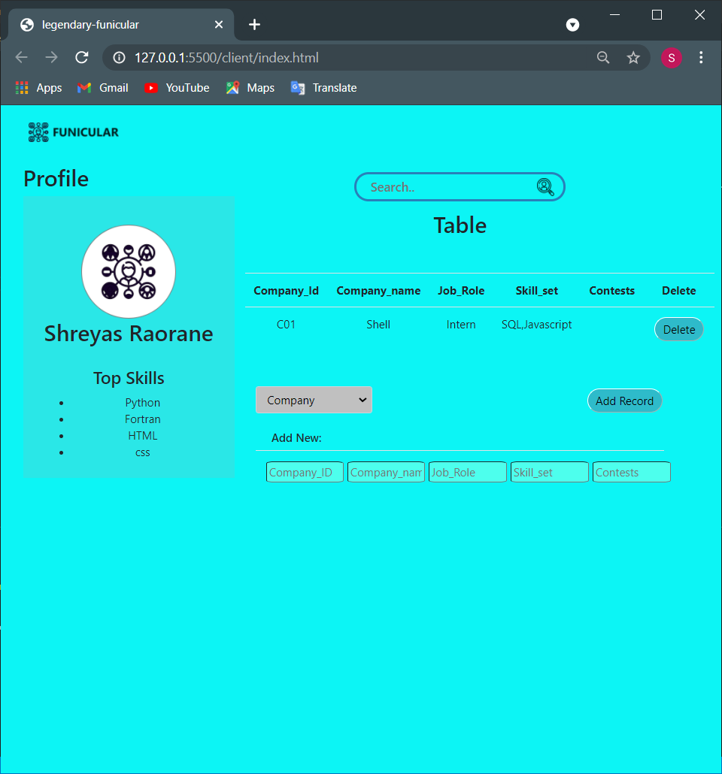
Search
Delete Corresponding record
Add New Record to the table

Slide 13
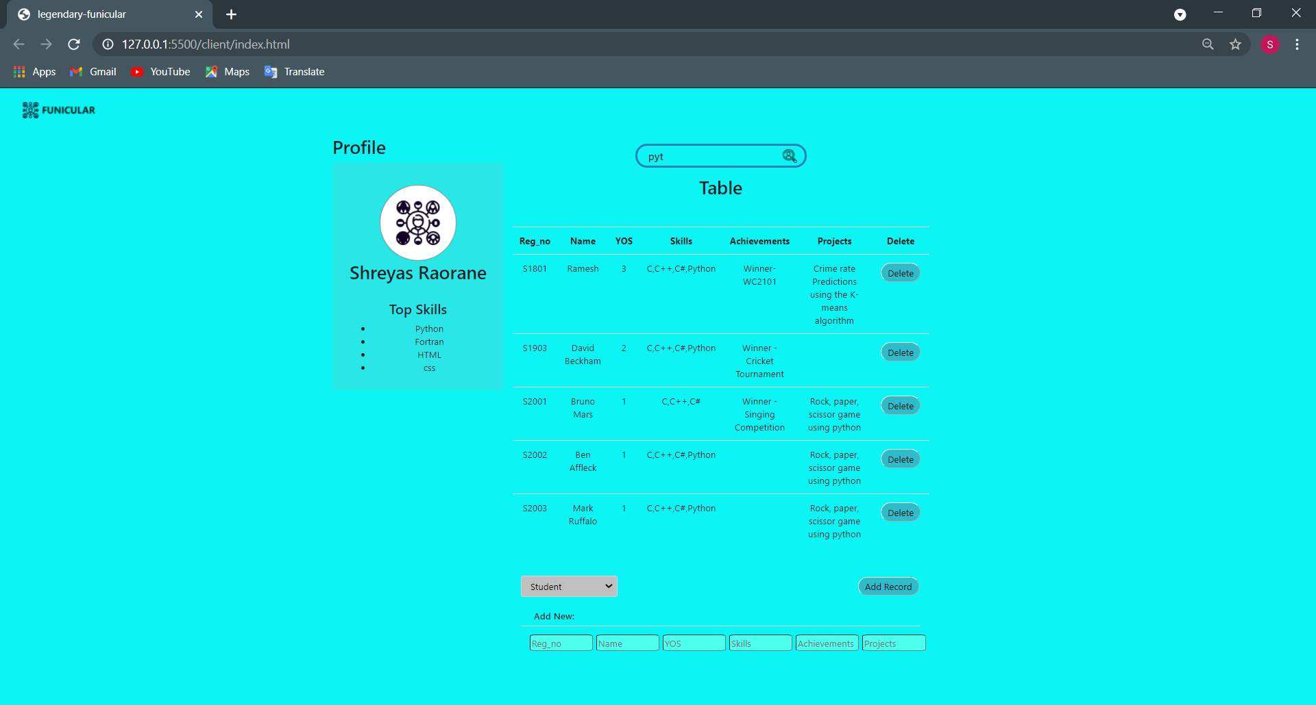
Search Example

Slide 14
References:
https://www.youtube.com/watch?v=vrj9AohVhPA
https://www.youtube.com/watch?v=Uvy_BlgwfLI
https://www.youtube.com/watch?v=eIjbSH3Imb8&t=227s
https://www.tutorialspoint.com/nodejs/index.htm
https://www.w3schools.com/bootstrap/
https://www.w3schools.com/nodejs/
https://www.w3schools.com/nodejs/nodejs_mysql.asp
https://www.javatpoint.com/expressjs-tutorial

Slide 15
Thank you!

